Slide 1
Software Engineering Prototyping
Notes:
Hi! In this video I will introduce the prototyping model. I will present the idea behind this model and several approaches – how to implement it. Later we will discuss the advantages and disadvantages of the model and finally we will see – when to use it. So – let’

Slide 2
Introduction
A software prototype is an incomplete software dedicated to demonstrate functionality.
Validate software to be created by using working prototype instead of using images and descriptions
Iterative / Incremental model
The practice of prototyping is one of the points Frederick P. Brooks makes in his 1975 book The Mythical Man-Month.
Many tools and techniques for prototyping, but the model is not frequently used.
Notes:
In order to talk about software prototyping, first we need to have a similar understanding – what is a software prototype. So, a software prototype is an incomplete software dedicated to demonstrate various aspects of the software such as design, functionality and other.
The idea of prototyping is to validate software to be created by using working prototype instead of using images and descriptions.
The prototyping software development model is an iterative / incremental model. The software is created iteratively as whole or in small increments.
The practice of prototyping appears in the famous book of Frederick Brooks „Them Mythical Man-Month“ released 1975.
The prototyping is a frequent technique in nowadays software development, but the prototyping as software development model is not used frequently. Anyway, let‘s get familiar with the idea of prototyping.

Slide 3

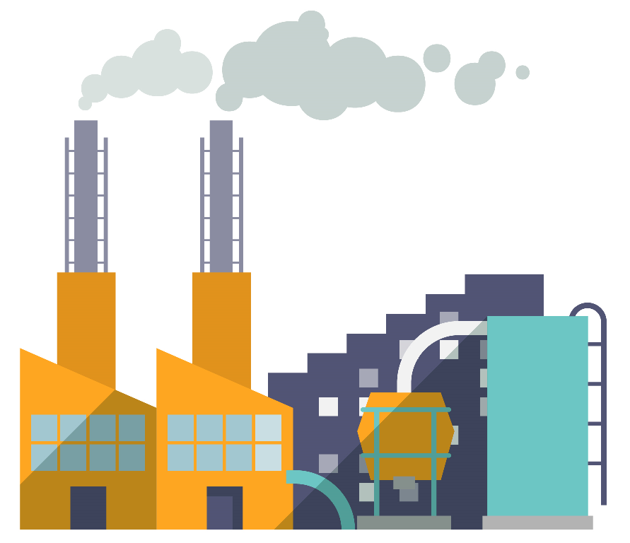
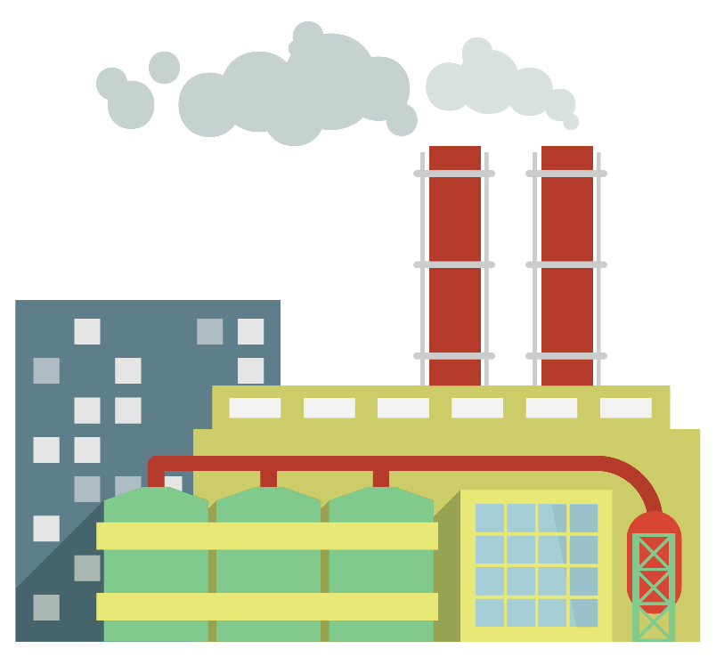
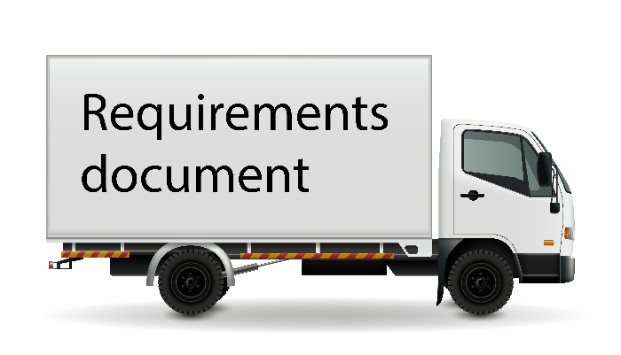

The idea of prototyping
Software prototype
Gather requirements
Build/Refine prototype
Evaluate prototype
No
Is prototype adequate?
Customer feedback
Yes
Proceed…
Notes:
Let‘s suppose, that we face several uncertain factors such as not clear requirements or technologies that are not well understood. So, we gather the initial, abstract requirements from the customer and build initial prototype. That prototype is provided to a customer for evaluation. The customer evalutes the prototype and provides a feedback. Now, the development team discuss the feedback and if the prototype is not adequate, then the team refines the prototype and provides the improved prototype for further evaluation. The team receives the feedback for further discussions. This cycle continues until a customer is happy with a prototype. And now the team proceeds. How!? It depends on a specific prototyping method. So, let’s investigate them.

Slide 4

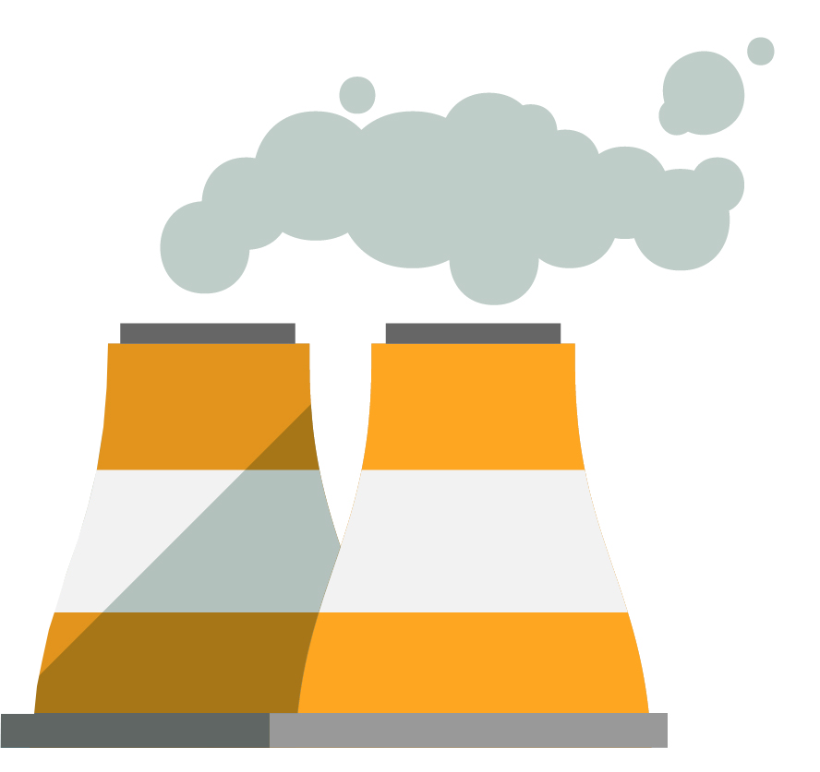
Throwaway prototyping
Software prototype
Gather requirements
Build/Refine prototype
Evaluate prototype
Software prototype
No
Is prototype adequate?
Yes
Customer feedback
Req., designs, sources, etc.
Use other development model
Notes:
There are two major methods. The first one is a „throwaway prototyping“ or a „rapid throwaway prototyping“. It‘s logical. If you‘ll need to thow away your prototype, better you do it fast so you don‘t get attached to your prototype and the work on the software to be thrown away is minimized. One might ask – why there is such a method at all. Well – this is balancing between pros and cons of the prototyping method. We will get to it, but you should know that sometimes it works very well.
So, start is the same as in previous diagram. The development team gathers the initial requirements and builds the software prototype. The prototype is provided to the customer for evaluation. Customer gives us a feedback and our development team refines the prototype if it is not good enough. Until this moment everything went the same as i presented in a previous slide. The difference is the outcome, when the customer and the team finds the prototype to be adequate. Now the useful things we discovered, such as refined requirements, designes, working algorithms and other, are provided for a development team that uses another software process to create the actual software. And the software prototype is thrown away.
Still, it is a bit pity to throw away the work you have done. Why not to keep it and improve so eventualy the prototype becomes the actual working software!? Yes, it is possible. I will present the second major method – the evolutionary prototyping.

Slide 5
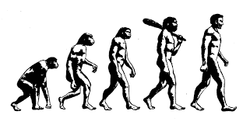
Evolutionary prototyping
Software prototype
Gather requirements
Build/Refine prototype
Evaluate prototype
No
Is system adequate?
Customer feedback
Software system
Yes
Deploy
Notes:
The evolutionary prototyping is very similar to thowaway prototyping. The development team gathers the initial requirements and builds the software prototype. The prototype is provided to the customer for evaluation. Customer gives us a feedback and our development team refines the prototype. Take into account, that in this model, the software system as such is evaluated. Therefore quality methods should be applied to verify and validate software in contrast to throwaway prototyping. When the created system becomes adequate, it is deployed.
Before discussing advantages and disadvantages of the prototyping methods let’s investigate two special cases.

Slide 6
Incremental prototyping
Software prototype
Gather requirements
Build/Refine prototype
Evaluate prototype
No
Is increment adequate?
Customer feedback
Software increment
Yes
Deploy
Notes:
The first one is related to the deployment of the software using small increments. It means that the software is split in a number of subsystems and each subsystem is being developed using evolutionary prototyping.
Again, the development team gathers the initial requirements and builds the software prototype. The prototype is provided to the customer for evaluation. Customer gives us a feedback and our development team refines the prototype of the increment if it is not good enough. The software increment is a part of the whole working software system. Therefore quality methods should be applied to verify and validate software as well. In the case the increment is good enough – it is deployed.
Now the team proceeds with the next subsystem or the process finishes if all subsystems are implemented.

Slide 7
Extreme prototyping
Software prototype
Gather requirements
Create/Refine UI design prototype
Create/Refine UI behavior prototype
Implement/Refine required services
Evaluate prototype
No
Is software adequate?
Customer feedback
Yes
Software increment
Deploy
Notes:
The extreme prototyping method initially was related to web projects. The mockups of user interfaces where created in html and provided for customers to validate it. Nowadays we can achieve similar results for many other platforms, therefore this method is not dedicated exclusively for web projects.
So, let‘s start with gathering the initial requirements. Now, as you will see, the prototype creation is split into 3 parts. First we create the user interface design. Next – we add the behavior so we can simulate how the software will work. And finally, we create the required services that implement that behavior. Note, that customer should not wait until the development team creates the working prototype. The customer can evaluate the design and the behavior before we start implementing the required functionality. It allows to save a lot of time.
After the software becomes adequate we can deploy it in increments or as whole.

Slide 8
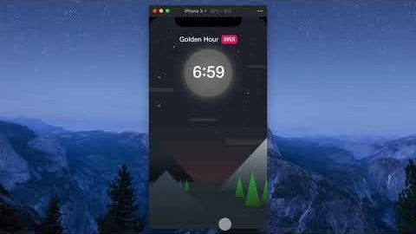
The example of prototyping
https://www.youtube.com/watch?v=vTgKtoU--Z8
Notes:
Now you will see a video that demonstrates an invision prototyping tool. You will get an idea what extreme prototyping is about.

Slide 9

The advantages
Intensive customer involvement.
The early determination of what the user really wants can result in faster and less expensive software.
Missing functionalities can be easily figured out.
New requirements can be easily accommodated as there is scope for refinement.
Notes:
The model has many advantages of the iterative models. There is quite intensive customer involvement. Even more intensive when compared to Agile models. The early determination of the user needs sometimes allows to build software faster. Because of frequent customer involvement, the missing functionalities can be easily figured out. Also this model embrace the changes as the refinements are a part of a model.

Slide 10

The challanges
Difficult planning because of uncertain number of iterations.
Insufficient analysis and focus on limited prototype can lead to overlooking better solutions.
Developers in a hurry to build prototypes may end up with sub-optimal solutions.
The system structure tends to degrade.
Poor Documentation due to experiments and continuously changing customer requirements.
Customer confusion of prototype and finished system.
Notes:
On the other hand – there are challenges as well. This model is a risky one and it has the difficulties in planning because of uncertain number of iterations. Also, if team focuses on prototyping it can lead to overlooking better solutions. If we use rapid prototyping, developers may end up with sub-optimal solutions because of the rush. The important thing is that the system structure tends to degrade if the team use evolutionary prototyping. For example, at some point the team might find out that they have chosen wrong architecture to accommodate newly discovered requirements. Prototypes are not documented very well, because of its nature. And sometimes there are issues with customers who do not understand prototyping and confuse a prototype with a finished system. Usually there is a long way from the prototype to the complete software.

Slide 11

When to use this model?
The requirements of the product are not clearly understood or are unstable.
The technologies are not well-understood.
There is a need to demonstrate the technical feasibility or a proof of concept of the product.
Good for developing user interfaces, high technology software-intensive systems, and systems with complex algorithms and interfaces.
Notes:
At the beginning i told that this model is not used frequently. Also we have reviewed several drawbacks of this model. Still, it doesn‘t mean that this model is not useful. Let‘s see, when to use this model. As the name implies, we should use this model when we face uncertain things such as obscure or unstable requirements, unknown technologies or other. The prototyping allows to remove such obstacles in the early phases of a project.
Furthermore, it is a very good model to demonstrate the technical feasibility proof of concept of a product to demonstrate that some kind of product could be created or vice versa. For example, there are popular events called „hakathons“. Normaly, there are given 3 days to create the prototype and demonstrate an idea of the product. The best ideas and prototypes are rewarded and the creators are encouraged to develop their idea. Many game are born in such a way.
As mentioned before, this model fits good for developing user interfaces, high technology intensive systems, systems with big complexity.
This model is popular in scientific institutions such as research institutes or universities. The scientists create prototypes proving that some kind of inventions can work. Later on, the prototypes are adopted by software companies through a technology transfer process. Larger companies themselves have R&D departments which have similar purpose.

Slide 12

Key points
The prototyping model is an iterative / incremental model.
Validate software to be created using working prototype instead of using images and descriptions.
The model is good when we face many uncertain factors (requirements, technologies, etc.).
This model is a risky one and it is difficult to plan a development of a project.
Notes:
To conclude – the prototyping model is an iterative model that can use incremental deployment. The main idea is to validate software to be created by using a working prototype. This model is good when we face uncertain factors such as unclear requirements or technologies. One of the best ways to solve it – is to use the prototyping. On the other hand, this model is a risky one. It is difficult to plan the development of a project because of uncertain number of iterations.

Slide 13
Thank for your attention!
Notes:
Thank you for watching. See you!

